Slide 1
Protos, JSON,...or?
By Raul Maldonado
PyBay 2018, Lightning Talk: @Cloud_Chaoszero

Slide 2
Motivation
We would like to serialize structured data to transmit information over networks to avoid intensive cpu executions and related risks.
So, we use a serialization mechanism to enable faster* data transfer of platform independence, data interexchange over heterogeneous distributed systems, and more
PyBay 2018, Lightning Talk: @Cloud_Chaoszero

Slide 3
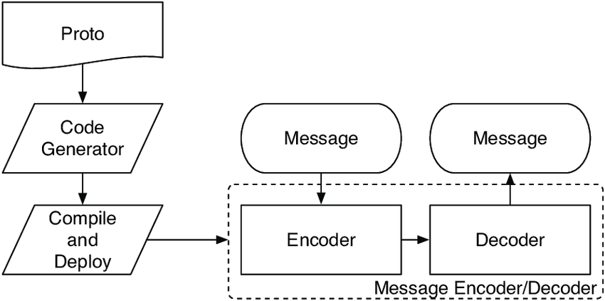
Protocol Buffer
syntax = "proto2"; package tutorial; message Person { required string name = 1; required int32 id = 2; optional string email = 3; enum PhoneType { MOBILE = 0; HOME = 1; WORK = 2; }
message PhoneNumber { required string number = 1; optional PhoneType type = 2 [default = HOME]; } repeated PhoneNumber phones = 4; }
Created by Google, Protocol Buffers are a binary encoding format of data into efficient and extensible format.
Facts
Schema declaration for over-the-wire data transfer to/from services. Ensure signals are valid
Backward Compatible for older datatypes
New fields could be introduced, and in-between servers need not inspect data
Validations: required, optional, repeeated keywords
Ease of Language Interpretability
PyBay 2018, Lightning Talk: @Cloud_Chaoszero
Notes:
Image Resource

Slide 4
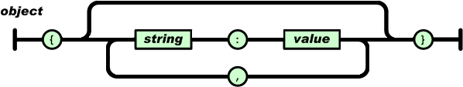
JSON
{ "firstName": "John", "lastName": "Smith", "isAlive": true, "age": 27, "address": { "streetAddress": "21 2nd Street", "city": "New York", "state": "NY", "postalCode": "10021-3100" }, "phoneNumbers": [ { "type": "home", "number": "212 555-1234" }, { "type": "office", "number": "646 555-4567" }, { "type": "mobile", "number": "123 456-7890" }
}
Javascript Object Notation (JSON) is a minimal format for structuring data.
Use of Keys and Values
Built on two structures
Collection of name/value pairs
Ordered list of values
Javascript object is not JSON, and JSON is not a Javascript only object
PyBay 2018, Lightning Talk: @Cloud_Chaoszero
Notes:
https://stackoverflow.com/questions/383692/what-is-json-and-why-would-i-use-it

Slide 5
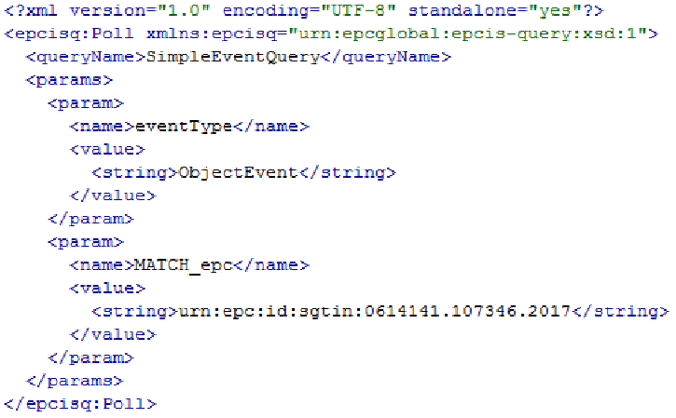
XML
eXtensible Markup Language (XML)
Tags and Attributes
PyBay 2018, Lightning Talk: @Cloud_Chaoszero

Slide 6
Compare and Contrast
Protocol Buffer
Dense and small output, memory saver
Hard to decode without knowing schema (in the case of security meausres)
Fast Processing
JSON
Human Readible
Can be parsed without knowing schema in advance
Somewhat verbose
Not Doc. Markup Language
XML
Human, but verbose, Readible
Parsed without knowing schema in advance
Standard for SOAP and other implementations
Document Markup Language
PyBay 2018, Lightning Talk: @Cloud_Chaoszero

Slide 7
Other Communication Protocols
Apache Thrift
eProsima Fast Buffers
SGML
PyBay 2018, Lightning Talk: @Cloud_Chaoszero

Slide 8
Resources and Contact Information
Resources
Protocol Buffers (Python)
Protocol Buffer Overview
5 Reasons to use Protocol Buffers
Contact Information:
LinkedIn: in/raulm8/
Github
Website: https://cloudchaoszero.github.io/
Twitter: See bottom right of screen
PyBay 2018, Lightning Talk: @Cloud_Chaoszero

